Slide 1
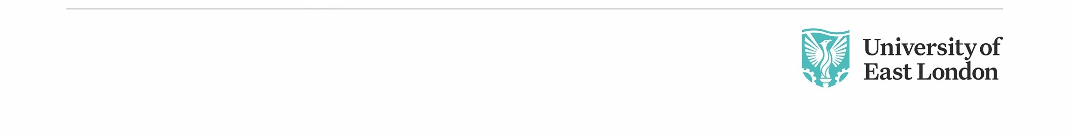
Lesson 9: CN4003
Advance JavaScript
Dr Fadi Safieddine
Dr. Fadi Safieddine Copyright 2021
1

Slide 2
Last week
Client-side scripting Verses Server-side scripting.
Using the <Script> …..</Script>
Using variables in JavaScripting.
Using Alert, Confirm, and Prompt as interactions.
Use of Events in JavaScript.

Slide 3

Lecture Content
Continuing JavaScript
Additional making Decisions:
IF statements
Do looping
Look at examples of JavaScript online:
Using Buttons
Validating a form (Very important)
Finishing the assignment:
Where to review the assignment
Last formative feedback opportunity.

Slide 4
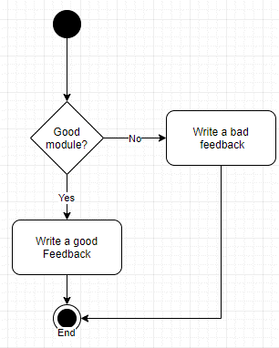
Making Decisions
When creating scripts, there are times when we have more than one option that we would like to explore.
Depending on the input, the script could produce different values.
In essence, the script makes a decision depending on the situation.

Slide 5
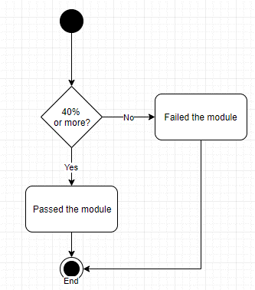
Making Decisions
Comparison Operators:
== (is Equal to)
!= and <> (is not Equal to)
> (Greater than)
< (Less than)
>= (Greater than or equal)
<= (Less than or equal)

Slide 6
Now Try this:
Write the formula for this case.
If the PRICE is more than £100, apply 10% discount. Otherwise, no discount.
If PRICE > £100 Then
Apply 10%
EndIF

Slide 7
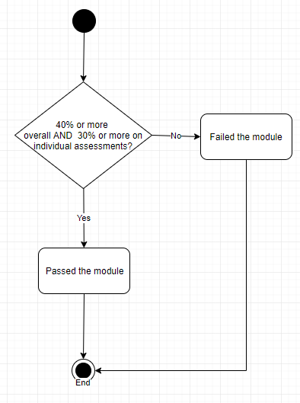
Making Decisions
Logical Operators:
Tend to happen when we have more than one condition at the same time.
&& (AND)
|| (OR)
! (NOT)

Slide 8
Making Decisions
if (Overall >= 40) && (Individual >= 30)
{document.write(‘You passed.’);}
Else
{document.write(‘You did not pass.’);}

Slide 9

Making Decisions
Switch:
Tend to be used when we have many possible inputs with different outputs.
SWITCH (Grade){ case (<40): Message = ‘You did not pass.’; break; case (>=40)&&(<55): Message = ‘You passed.’; break; case (>=55)&&(<70): Message = ‘You passed with merit’; break;
case (>=70) Message = ‘You passed with distinction’; break; default: Message = ‘Incorrect grade’; break;}
Grade = 57
You passed
with merit

Slide 10

Loops: Other variations
Loops: Other variations
DO loop:
var P = 0;
do {
P = P + 1
document.write("Hello World"); document.write("</BR>");
} while ( P < 4);
Hello World
Hello World
Hello World
Hello World

Slide 11
End of Part 1
Activity 9.1. Try these codes and tell us what they generate:
Case 1: Run the programme
var x = 1;
do {
X = X + 1
document.write(“I can do JavaScript!"); document.write("</BR>");
} while ( P <=10);
Case 2: Student gets overall 70% but one of the individual assessment 35%.
if (Overall >= 50) && (Individual >= 40)
{document.write(‘You passed.’);}
Else
{document.write(‘You did not pass.’);}

Slide 12

Functions:
Part 2

Slide 13

Functions:
A function allows you to group together a block of code that perform a specific task.
You are then able to “Call” this function as many times as you need.
This saves you time having to write the code again and again.

Slide 14
Functions:
The Code:
function Greetings() { document.write(“Hello World”); }
How do you call it?
Greetings();

Slide 15
Functions:
We could do calculations:
function Additions(X,Y) { document.write(“The total is ”);
document.write(x+y); }
How do you call it?
Additions(4,10);
The total is 14
Additions(12, 4)
The total is 16

Slide 16
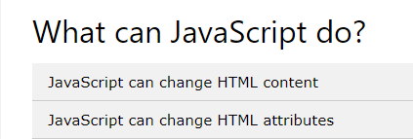
Class Practice
We shall practice several examples:
https://www.w3schools.com/js/js_examples.asp

Slide 17
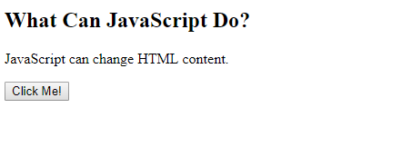
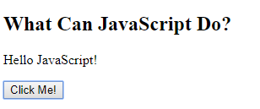
Buttons and JavaScript

Slide 18
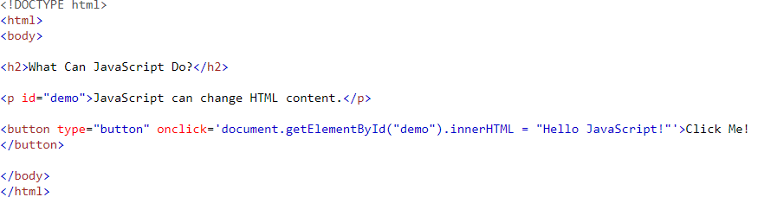
Buttons and JavaScript

Slide 19
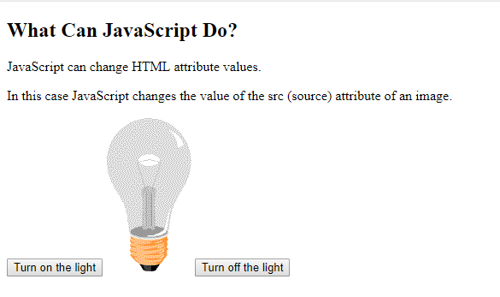
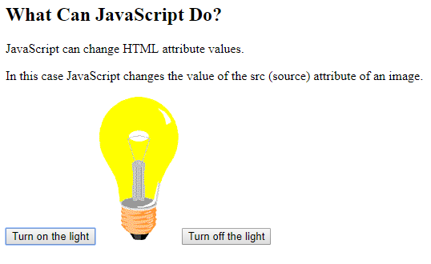
Turn light on and off
https://www.w3schools.com/html/tryit.asp?filename=tryhtml_script_attribute

Slide 20
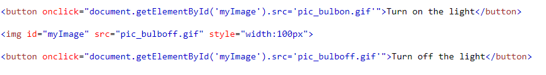
Turn light on and off
Before you can do this code, you will need to download two images from the page:
pic_bulbon.gif and pic_bulboff.gif
https://www.w3schools.com/html/tryit.asp?filename=tryhtml_script_attribute

Slide 21
End of Part 2
Lab Activity 9.1. Add the flashing light bulb to any of the pages you created before.
Test it.
Save it.
If you feel like being creative, change the code. (optional)

Slide 22
Form Validation
Part 3
22

Slide 23
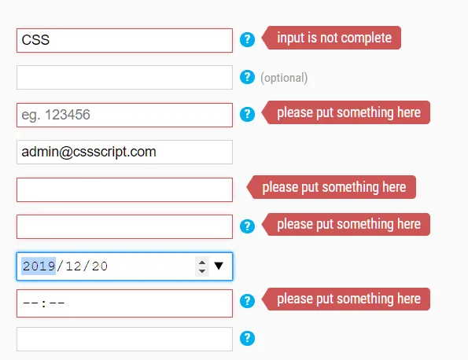
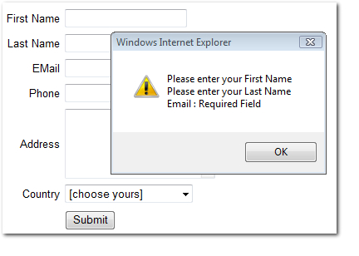
Form Validation
Part 3
23

Slide 24
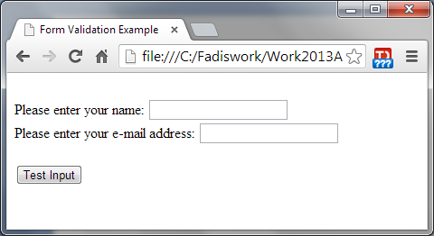
Form Validation
<html>
<head>
<Title> Form Validation Example </Title>
<script language="JavaScript">
function ValidationCheck(form) {
if (form.NameInput.value == "")
alert("You forgot to put anything for Name!")
if (form.EmailInput.value == "" || form.EmailInput.value.indexOf('@') == -1)
alert("You did not put a valid Email!");
}
</script>
</head>
<body>
<form name="DemoForm">
</br>
Please enter your name: <input type="text" name="NameInput"> </br>
Please enter your e-mail address: <input type="text" name="EmailInput"></br>
</br>
<input type="button" name="button1" value=“Test Input" onClick="ValidationCheck(this.form)">
</form>
</body>
</html>
24

Slide 25
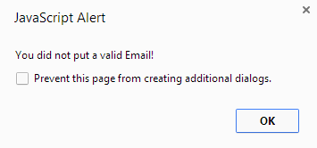
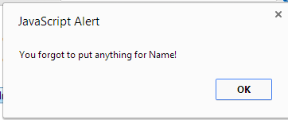
Outcome:
25

Slide 26
JavaScript vs. Java
JavaScript
interpreted (not compiled) by client
object-based (code uses built-in, extensible objects, but no classes or inheritance)
code integrated with and embedded in HTML.
Java
compiled on server before execution on client
object-oriented (applets consist of object classes with inheritance)
applets distinct from HTML (accessed from HTML pages)
26
Notes:
9
9

Slide 27
JavaScript vs. Java
JavaScript
variable data types not declared (loose typing)
dynamic binding (object references checked at run-time)
security: cannot write to hard disk
no graphics library, no threads, no networking
Java
variable data types must be declared (strong typing)
static binding (object references must exist at compile-time)
security: multilevel control
graphics library (AWT), threads, networking (sockets, RMI, etc.)
27
Notes:
9
9

Slide 28
Connecting to Java
JavaScript now shares a closer relationship to Java
<applet code= " JavaApplet.class" width="350" height="350"> <!--The app will appear here </applet>
JavaApplet.class is the Java programme applet that links to the page.
Browsers tend to block these programmes unless they are checked for malicious codes.
28

Slide 29
End of part 3
Lab Activity 9.2. Edit the form validation JavaScript practice from the lab folder as following:
Add a comment section (remember the code for previous lessons).
Add that under the input test.
Add the JavaScript code to alert the user if they forget to write in the comments.

Slide 30
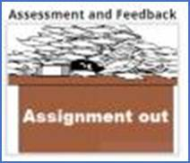
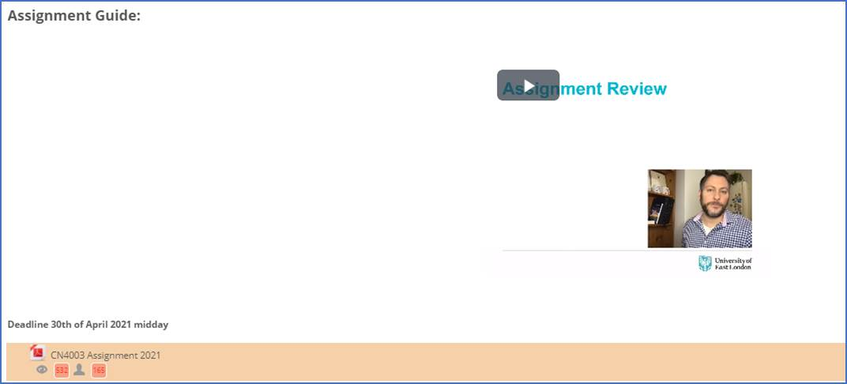
Please refer to the assignment
Part 4

Slide 31

Next lecture:
Review of Web design
Is it a matter of taste?

